Slide 1
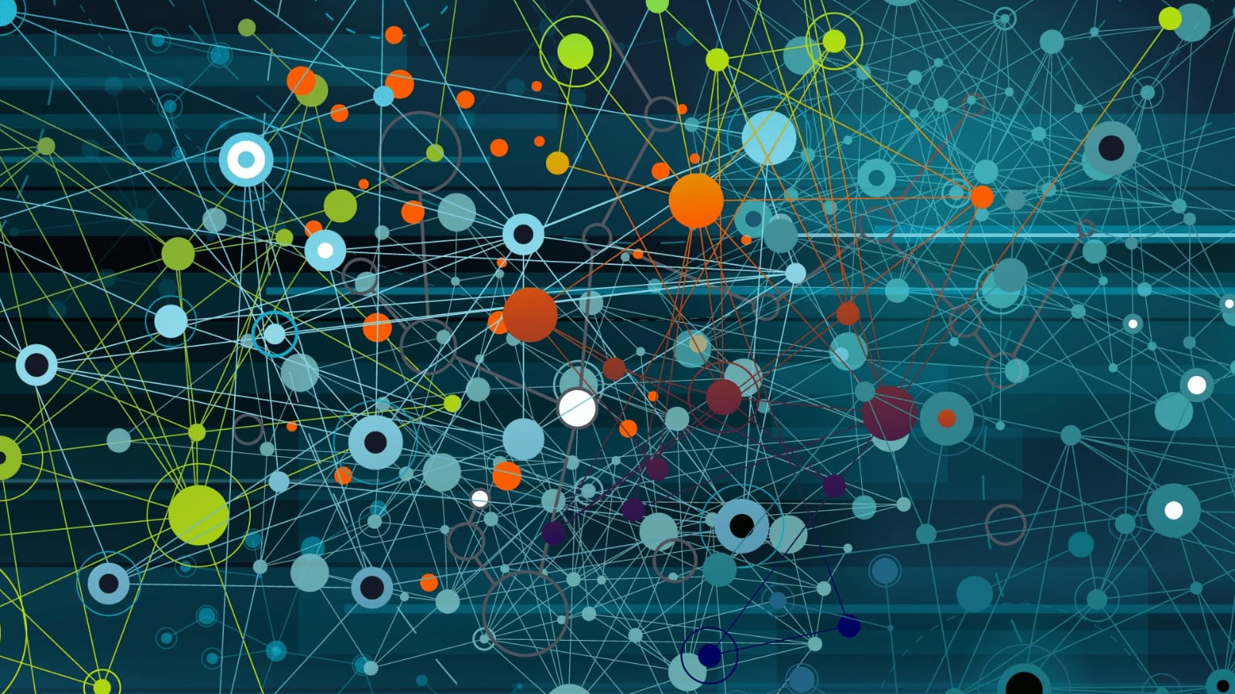

Adversarial Image Attack Defenses: A Study of effects of FGSM, Patch and CW Attack

Slide 2



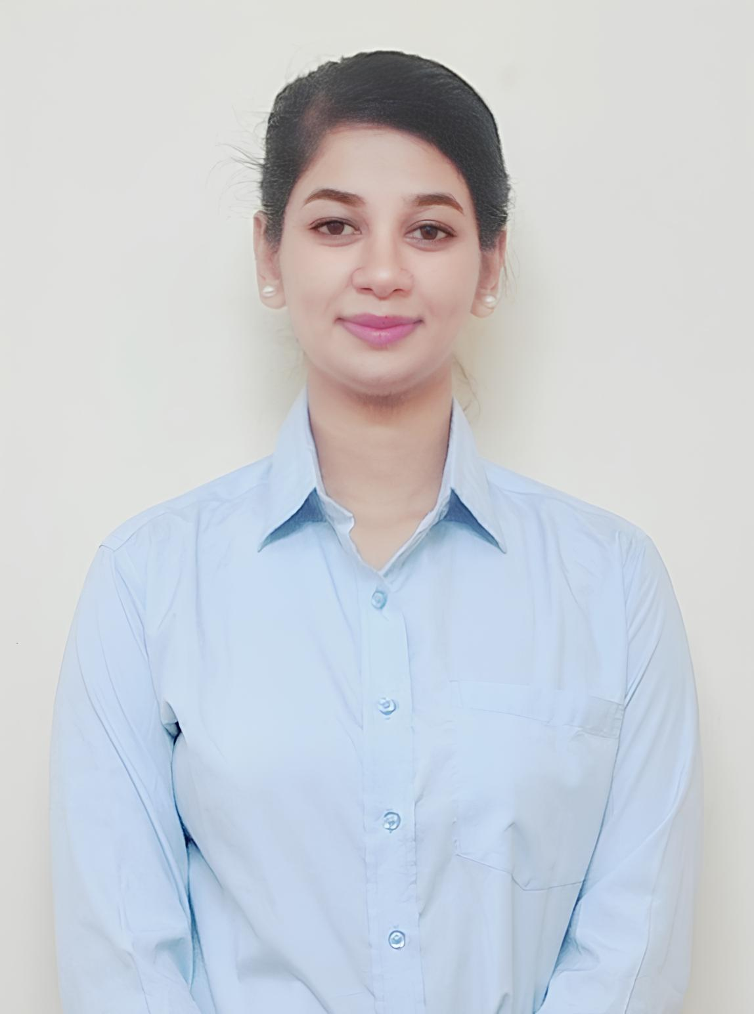

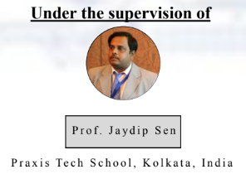
Presented By
Koustav Mazumder
C24-006
Mili Chowdhury
C24-008
Pratishruti Sahoo
C24-009
Jyoti Mallik
C24-005
Anup Kumar raj
C24-018

Slide 3

Adversarial Attacks and Defenses in Image
Classification
As machine learning drives critical applications like autonomous vehicles, facial recognition, and medical diagnostics, ensuring their reliability and security becomes paramount. A major challenge, especially for image classification tasks, is the susceptibility of machine learning models to adversarial attacks. These attacks involve making subtle changes to input data that trick deep neural networks into making incorrect predictions, which can have serious real-world consequences.

Slide 4
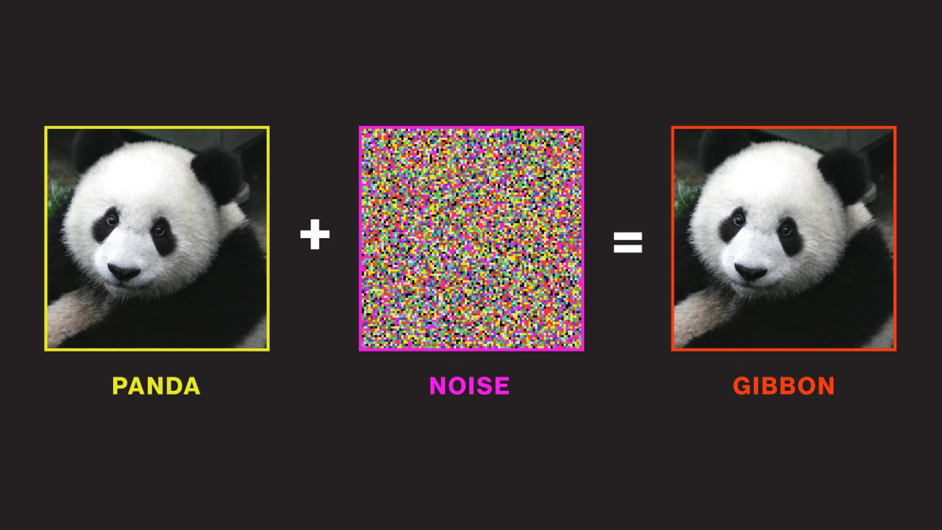
Image Attack
In Summary,

Slide 5
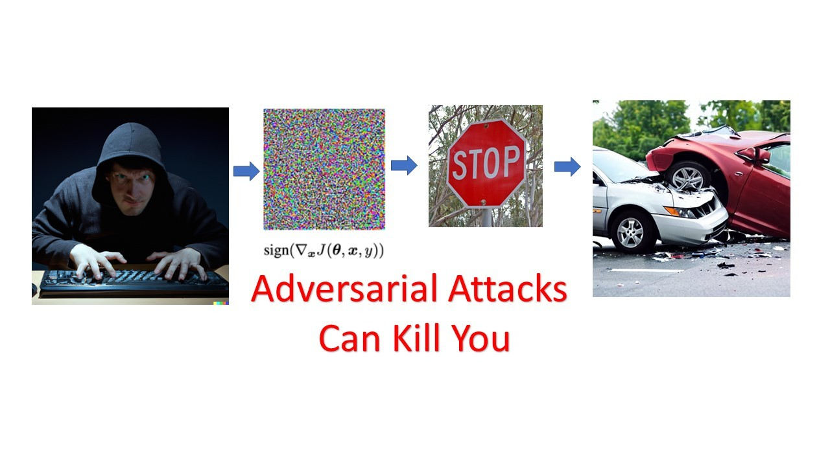

Slide 6
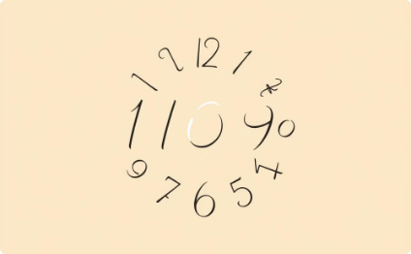

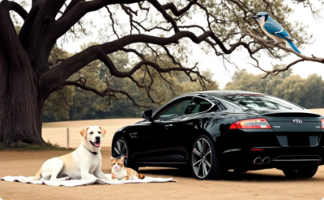

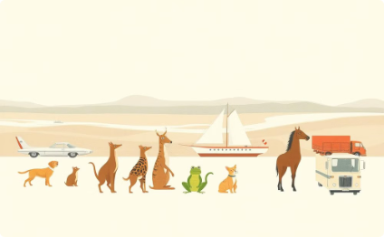
Commonly Used Datasets for Image Classification
1) MNIST Dataset (Handwritten Digits)
2) ImageNet (Large-Scale Object Recognition)
3) Tiny-ImageNet (Subset of ImageNet)
Images: 70,000 grayscale, 28x28 pixels Classes: 10 (digits: 0-9) Use: Benchmark for simple image classification tasks
Images: 14+ million labeled images Classes: 1,000 (diverse objects) Use: Object recognition and large-scale visual recognition challenges (e.g., ILSVRC)
Images: 200 classes, 500 training & 50 validation images/class (64x64 pixels) Use: A manageable, smaller version of ImageNet for faster experimentation
Chosen Dataset: Tiny-ImageNet We have selected Tiny-ImageNet for our experiments due to its balance between complexity and computational efficiency, allowing for manageable training times while maintaining diverse image classes.
4)CIFAR-100 (Detailed Object Classification)
5) CIFAR-10 (General Object Classification)
Images: 60,000 color, 32x32 pixels Classes: 100 (grouped into 20 superclasses) Use: More detailed classification compared to CIFAR-10
Images: 60,000 color, 32x32 pixels Classes: 10 (e.g., airplanes, birds, cars) Use: Benchmark for diverse category classification

Slide 7
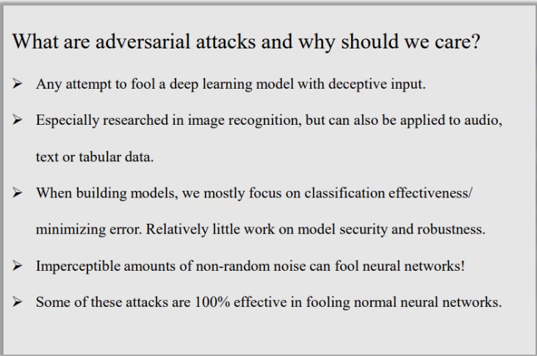
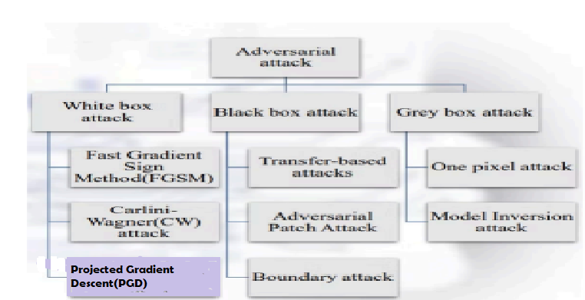
Adversarial Attack

Slide 8
Methodology
1. Choose pre-trained models: ResNet34, DenseNet161, EfficientNet
3. Apply FGSM, CW, Patch and PGD attacks to generate adversarial examples
5. Implement defense strategies: Adversarial Training, Input Transformations
7. Evaluate model performance post-defense against adversarial examples
1
2
3
4
5
6
7
8
2. Train and evaluate on Tiny ImageNet dataset to establish baseline performance
4. Increase attack strength (epsilon) incrementally for FGSM, CW, Patch and PGD
6. Perform Defensive Distillation with teacher-student framework
8. Conduct comparative aralysis of model robustness.

Slide 9
Pretrained Models on Tiny ImageNet Dataset
1
2
3
1: DenseNet161
2: ResNet34
3: EfficientNet
Architecture: Dense connections between layers to improve feature propagation.
Architecture: 34-layer deep residual network with skip connections.
Architecture: Compound scaling of depth, width, and resolution for optimal performance.
Pretraining: Trained on ImageNet and fine-tuned on Tiny ImageNet.
Pretraining: Trained on ImageNet and fine-tuned on Tiny ImageNet.
Pretraining: Trained on ImageNet and fine-tuned on Tiny ImageNet.
Strength: Efficient use of parameters, mitigating vanishing gradient.
Strength: Handles deeper networks by using residual blocks, avoiding vanishing gradients.
Strength: Balances accuracy and efficiency with fewer parameters.

Slide 10
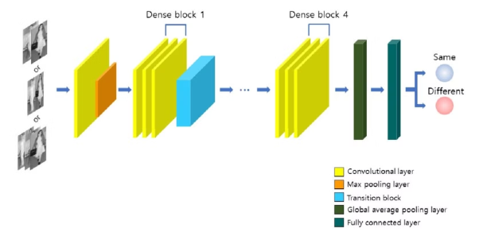
DenseNet161 Architecture
Densely Connected: Each layer connects to every subsequent layer in a feed-forward manner.
161 Layers with a Growth Rate of 48 (each layer adds 48 feature maps).
Key Components:
Dense Blocks: Promotes feature reuse and improved gradient flow.
Transition Layers: Downsample feature maps using 1x1 convolutions and 2x2 average pooling.
Bottleneck Layers: Use 1x1 convolutions to reduce dimensionality and computational cost.
Why DenseNet161?:
Efficient parameter usage due to dense connections.
Strong gradient flow, minimizing the vanishing gradient problem.
Ideal for deep architectures requiring feature reuse.

Slide 11
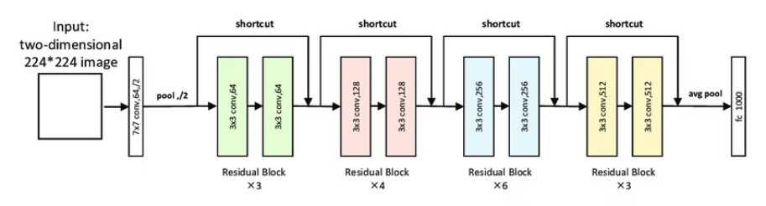
ResNet34 Architecture
34 Layers Deep with Residual Connections (skip connections) to prevent vanishing gradient issues and enable deeper networks.
Key Components:
Residual Blocks: Allow information flow across layers, improving learning in deep networks.
Batch Normalization: Stabilizes learning and improves convergence.
Global Average Pooling followed by a fully connected layer for classification.
Why ResNet34?:
Efficient handling of deep architectures via residual connections.
Excellent performance and convergence on image recognition tasks.
Robust against overfitting, even with deeper networks.

Slide 12
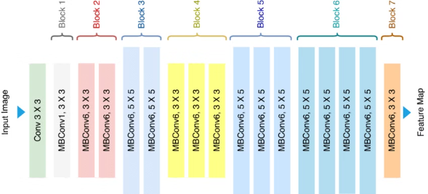
EfficientNet-B0 Architecture
Compound Scaling: Balances depth, width, and resolution for optimized performance and efficiency.
Smaller Model: Fewer parameters but high accuracy.
Key Components:
Depthwise Separable Convolutions: Reduces computation with efficient performance.
Squeeze-and-Excitation: Reweights channels for attention on important features.
MBConv Blocks: Combines efficient convolutions and residual connections.
Why EfficientNet-B0?:
Balanced accuracy and efficiency.
Scalable for various resource constraints.
State-of-the-art performance with minimal parameters.

Slide 13
FGSM Attack
1
2
3
Step 1: Gradient Calculation
Step 2: Perturbation Generation
Step 3: Model Misclassification
The Fast Gradient Sign Method (FGSM) leverages the gradient of the model’s loss function with respect to the input. This gradient indicates the direction of steepest ascent in the loss function, which corresponds to the direction that maximizes the model's error.
FGSM generates a perturbation by multiplying the sign of the gradient by a small constant called epsilon. This perturbation is then added to the original input image, creating an adversarial example.
The adversarial example, with its subtle but intentional perturbations, is then fed into the model. Due to the carefully crafted changes, the model is likely to misclassify the input, demonstrating its vulnerability to adversarial attacks.

Slide 14
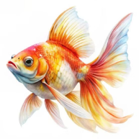
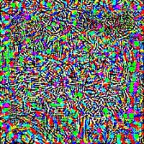
FGSM Attack: A Closer Look
The Fast Gradient Sign Method (FGSM) is a popular adversarial attack method. It leverages the gradient of the model's loss function to create a subtle yet effective perturbation. This perturbation is added to the original input image, causing the model to misclassify it.
FGSM is a simple yet powerful technique for crafting adversarial examples. It exploits the model's reliance on gradients, leading to misclassifications. +
Goldfish +
Noise
= Shark
It involves three steps:
Calculating the value of the loss function.
Computing the gradients for each pixel of the original image.
Making delicate adjustments to the pixels of the input image in alignment with the gradients to maximize the loss function.

Slide 15
Implementation - FGSM Attack
The FGSM attack algorithm is implemented in Python. This code defines a function that takes an image, a classification model, and an epsilon value as inputs. It then calculates the gradients of the model's loss function with respect to the image. Finally, it perturbs the image by adding the scaled gradients.
The perturbed image is then fed into the model for classification. If the model misclassifies the perturbed image, the attack has been successful. The epsilon value controls the strength of the perturbation. Larger values of epsilon lead to more significant changes in the image, potentially making it easier to fool the model.
Experiments were conducted to examine the effects of the FGSM attack on three pre-trained CNN models: DenseNet161, RESNET34, EfficientNet-B0,
The ImageNet dataset comprises 1000 classes on which the models were pre-trained, we opted to utilize the Tiny ImageNet, which contains 100 classes, for our evaluation.
Models are initially evaluated without attacks, followed by launching attacks to create adversarial images, and then reevaluating the models' classification performance using these adversarial images.

Slide 16
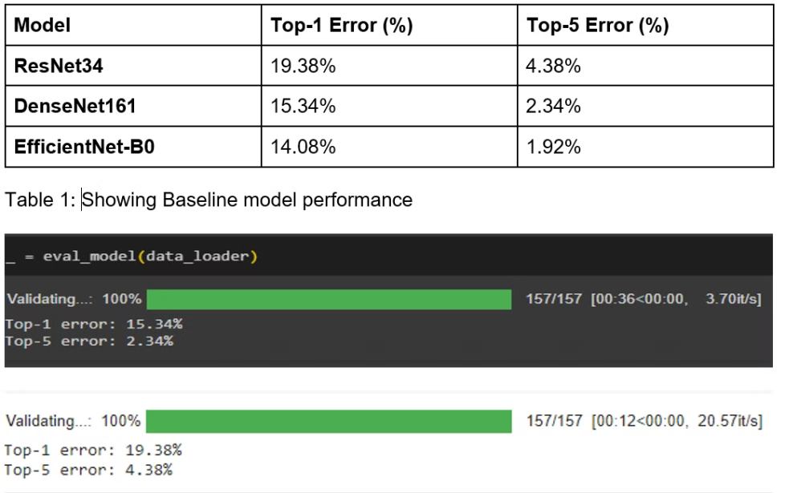
Results – In Absence of any attack
Before introducing adversarial attacks, we established the baseline performance of the three models (ResNet34, DenseNet161, and EfficientNet-B0) on clean, unperturbed data. The evaluation focused on top-1 and top-5 error rates, representing the percentage of predictions where the true label was not among the top 1 or top 5 predictions, respectively. The table and figures below will showcase these baseline results.

Slide 17
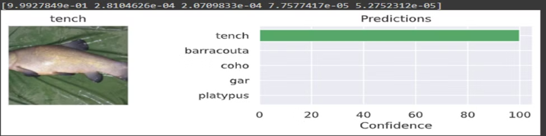
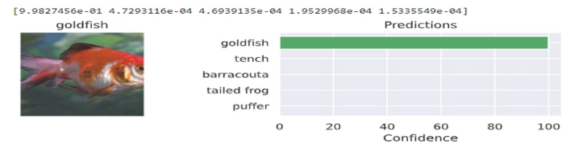
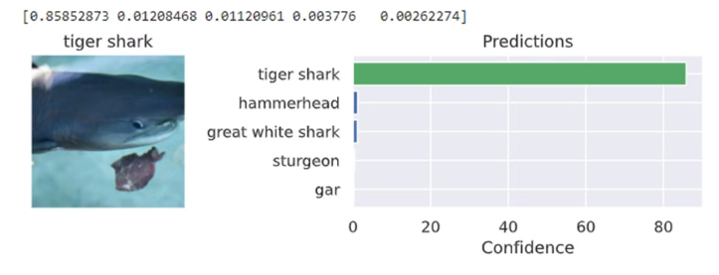
Fig1:DenseNet161 classifying tench with ~100% confidence
Fig2: Looks like Resnet34 found gold —it's 99.9% sure that it's a goldfish!
Fig 3: EfficientNet showing its efficiency

Slide 18
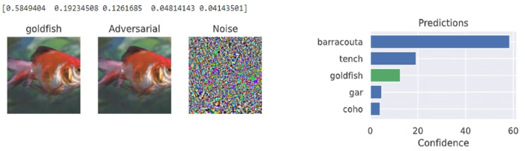
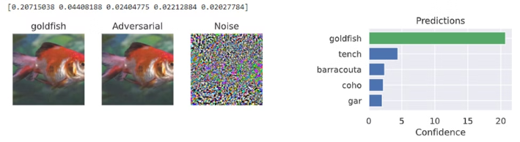
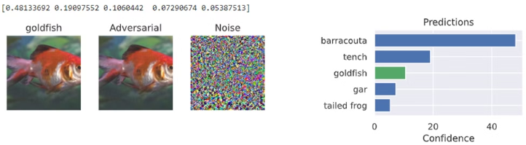
Results - In Presence of FGSM attack
Fig 4. for e=0.01 look at the confidence of the DenseNet161 for Goldfish
Fig 5. EfficientNet classified correctly with a depreciated value
Fig 6. ResNet34’s classification result of true class is also poor

Slide 19
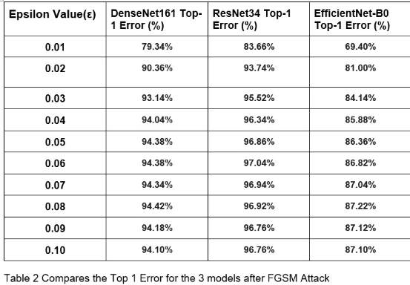
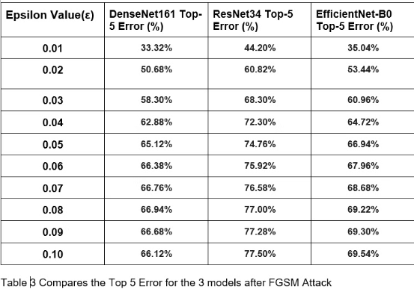
FGSM Attacks: Results and Analysis
The FGSM attack was applied to DenseNet161, ResNet34, and EfficientNet-B0 with increasing levels of perturbation. The attack was conducted with epsilon values ranging from 0.01 to 0.10. This slide shows the top-1 and top-5 error rates for each model across the epsilon range. The results indicate that all three models exhibit a significant rise in top-1 error rates as the epsilon value increases.
Interestingly, EfficientNet-B0 demonstrates greater resilience to FGSM perturbations compared to the other two models. This suggests that EfficientNet-B0 is more robust to adversarial attacks.

Slide 20
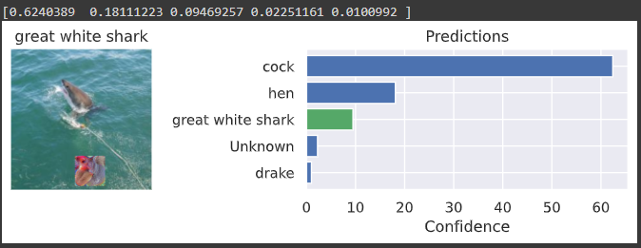
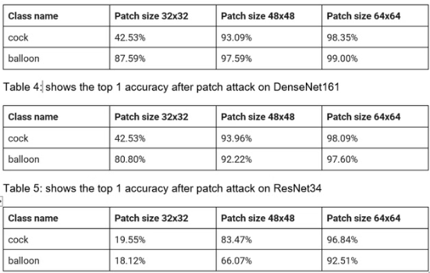
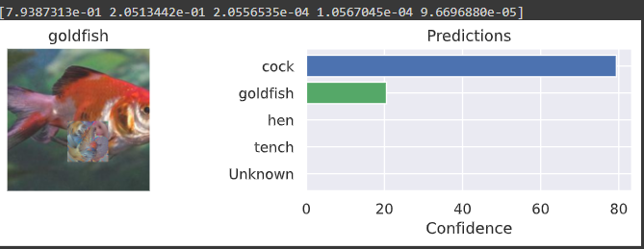
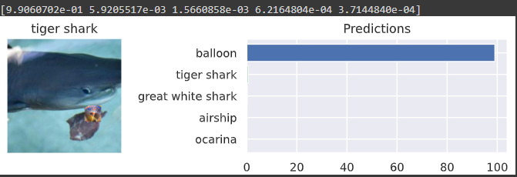
Patch Attack
Although the focus of the project was on perturbation-based attacks, a patch attack on the dataset using just two class [‘cock’ , ’balloon’] with 3 different patch sizes 32x32px, 48x48px and 64x64px with the assumption that the the larger patch will fool the model entirely and after the operation it was clearly visible that the model is classifying the patch object as the true object for bigger patch. Below are the results for all 3 models with the 3 patch sizes.

Slide 21

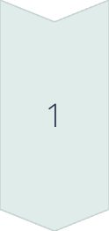
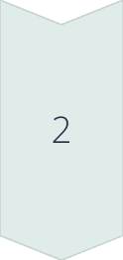

Projected Gradient Descent (PGD)
Initialization
PGD begins with an initial random perturbation of the input image. This perturbation is typically small and within a predefined range, ensuring that the adversarial example remains visually similar to the original image.
Iterative Updates
PGD then iteratively updates the perturbation based on the gradient of the loss function. After each update, the perturbed input is projected back onto the valid input space to keep the changes within the epsilon constraint.
Adversarial Example Generation
This iterative process continues for a specified number of steps, gradually refining the perturbation and pushing the model towards misclassification. The final perturbed image is the adversarial example, designed to fool the model with high confidence.

Slide 22
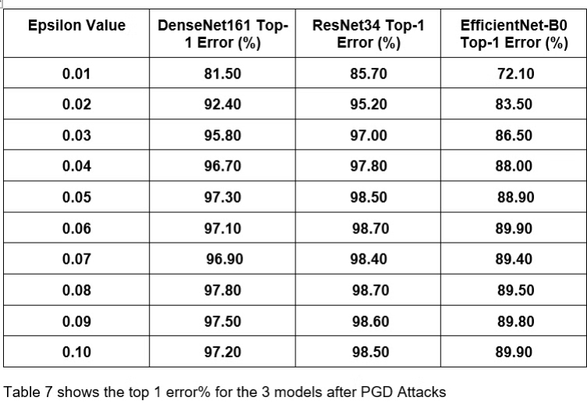
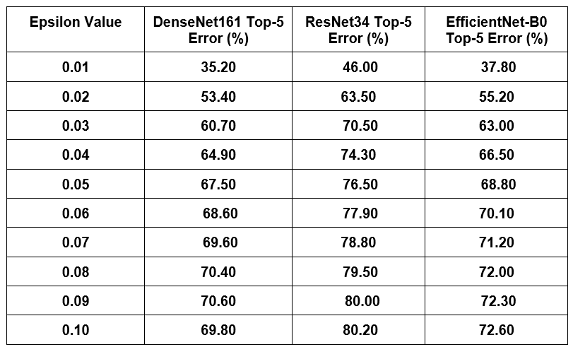
Projected Gradient Descent attack
In the next line of attack, the iterative adversarial attack. PGD was chosen with a range of 0.01-0.10 epsilon values. Its iterative nature makes it stronger compared to single-step approaches like FGSM, typically resulting in higher error rates. The table below presents the top-1 and top-5 error rates for DenseNet161, ResNet34, and EfficientNet-B0 under the PGD attack.

Slide 23

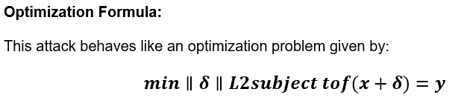
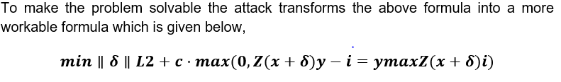
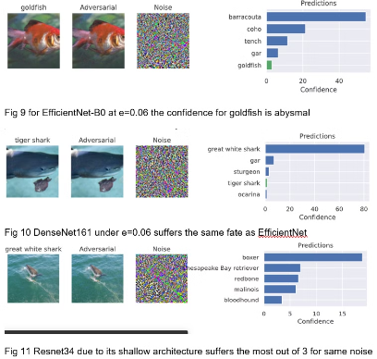
Finally, Carlini-Wagner (CW) Attack
In our analysis, the CW attack was applied to three models over a range of epsilon values (0.01-0.10). The epsilon (ε) represents the strength of the attack, with higher values corresponding to larger perturbations. The models were tested across various ε values to evaluate their resilience to adversarial perturbations. The primary focus was on minimizing the L2 norm of the perturbation while ensuring the target misclassification.

Slide 24
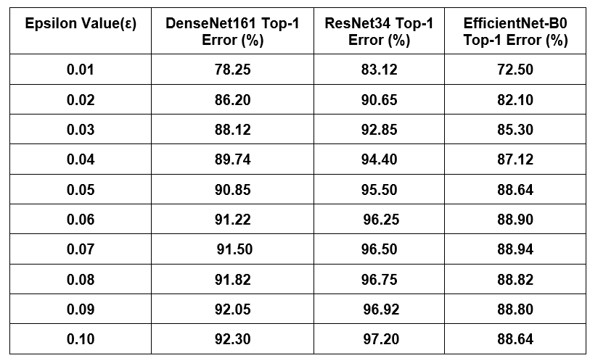
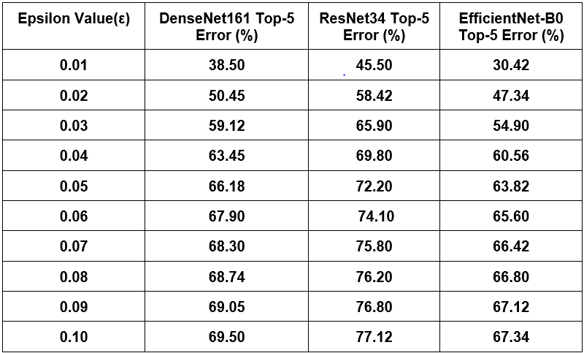
Carlini-Wagner (CW) Attack
Across all models, there is a clear upward trend in top-1 error and even in top-5 error rates as the epsilon value increases, indicating that the models become more vulnerable to adversarial perturbations as the attack strength grow.

Slide 25
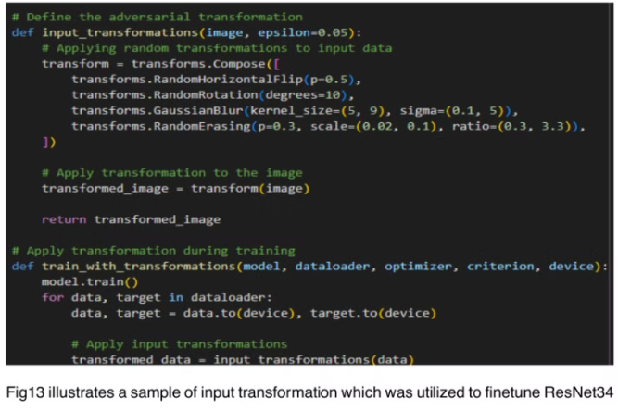
Defensive Measures
Input Transformation:
After undergoing all the attacks it was time to mitigate the impact of the adversarial attacks by incorporating defensive techniques like Input transformation, adversarial training and finally Defensive distillation. The applied transformations include:
● Random Horizontal Flip to flip the image horizontally with a probability of 0.5.
● Random Rotation to randomly rotate the image by up to 10 degrees.
● Gaussian Blur to apply a blur with a kernel size between 5 and 9 and a sigma between 0.1 and 5. Random Erasing to randomly erase
a portion of the image with a probability of 0.3.

Slide 26
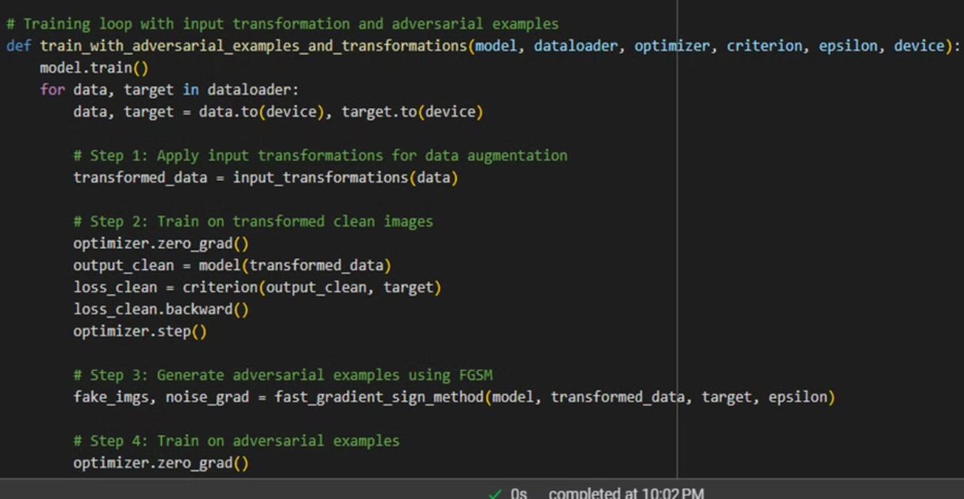
Adversarial training function

Slide 27
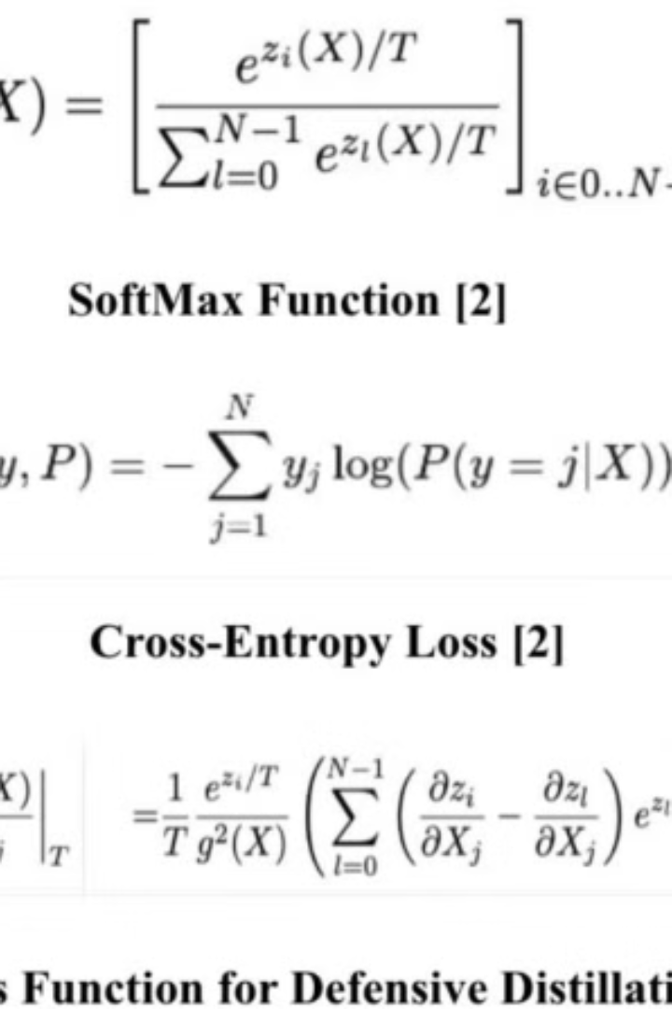
Defensive Measures
Knowledge distillation: Transferring knowledge from a big model to a smaller one for similar results by using class probability vectors from the larger model to train the smaller one [2] .
➢ SoftMax Function [F(X)] : Used in defensive distillation, it converts the last hidden layer's output into a probability distribution over classes in classification tasks [2].
➢ Cross-Entropy Loss [ H(y,P) ]: It measures the dissimilarity between the predicted probability distribution and the true distribution of the labels

Slide 28




Defensive Measures
Smoother Decision Boundaries
Defensive distillation trains models using softened probability distributions, often referred to as soft labels, instead of the standard hard labels. This smooths the decision boundaries of the model, making it less sensitive to small input perturbations that adversarial attacks exploit.
Teacher-Student Approach
The process involves training a smaller "student" model using soft labels from a larger pre-trained "teacher" model. This transfer of knowledge helps the student model learn smoother decision boundaries, making it more resilient to adversarial attacks.
Improved Robustness
By training on these softened outputs, the student model becomes less sensitive to small input perturbations because the decision boundaries are smoother. The student model is thus harder to fool with adversarial examples.

Slide 29
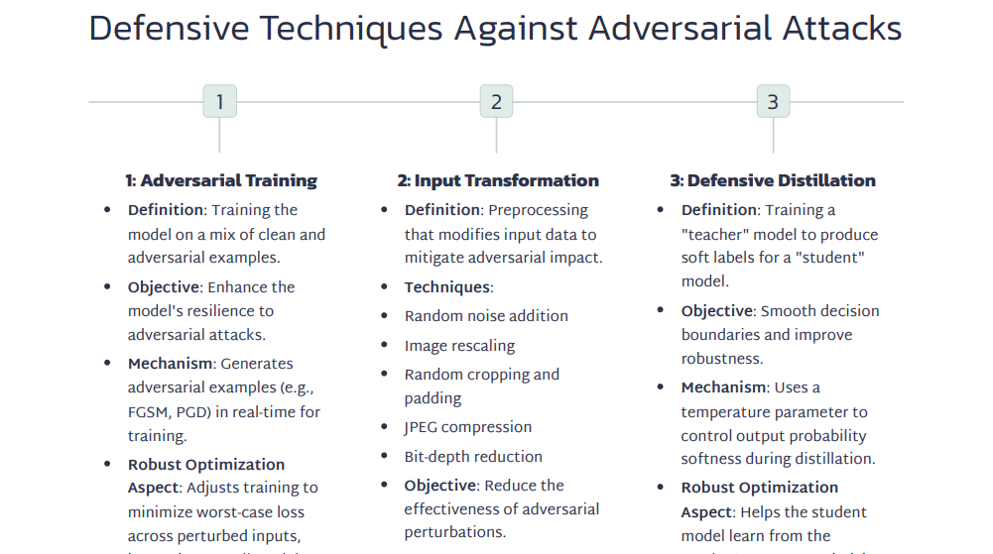
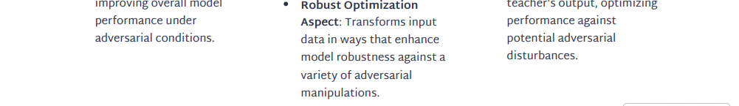

Slide 30
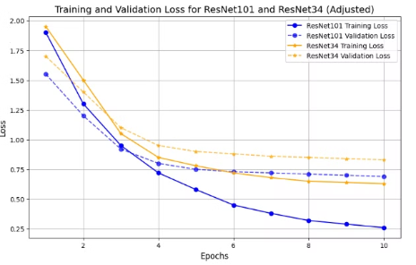
Defensive Mechanisms Implementation
Input Transformation Techniques:
Random Horizontal Flip (p=0.5), Random Rotation (up to 10°), Gaussian Blur (kernel size 5-9, sigma 0.1-5), and Random Erasing (p=0.3) applied during training.
Transformations disrupt adversarial noise, improving model robustness.
Adversarial Training:
FGSM and PGD attacks used to generate adversarial examples during training.
Adversarial examples mixed with clean images to enhance decision boundaries, making the model more resilient to adversarial attacks.
Defensive Distillation:
Teacher model (ResNet101) trained, producing soft labels for student model (ResNet34).
Softened decision boundaries improve robustness against attacks like FGSM and CW.

Slide 31
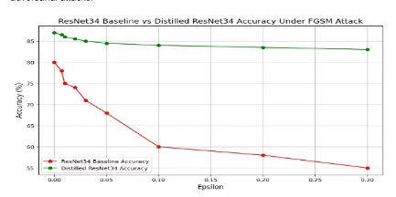
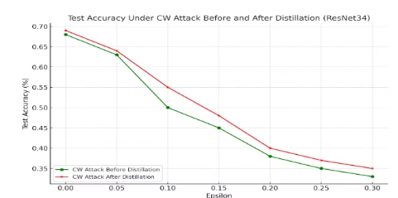
Results of Defensive Mechanisms on FGSM and CW Attacks
Performance on FGSM Attack:
Baseline ResNet34 accuracy ranged from 80% to 55% across different epsilon values (0 to 0.30).
After distillation, the student model showed significantly improved stability, with accuracy ranging from 87% to 84% across epsilon values.
Performance on CW Attack:
Distilled model showed better resilience to weaker CW attacks (ε<0.05), with a slower decline in accuracy.
However, as the strength of the CW attack increased (ε>0.20), the benefits of distillation diminished, with performance dropping similarly to the baseline model.

Slide 32
Performance Analysis and Results
Baseline Performance
FGSM Attack Results
PGD Attack Results
C&W attack results
Before applying adversarial attacks, we evaluated the baseline performance of the three models—ResNet34, DenseNet161, and EfficientNet-B0—on clean, unperturbed data. The evaluation focused on top-1 and top-5 error rates, which indicate the percentage of predictions where the true label was not within the top 1 and top 5 predictions, respectively.
The attack was applied to DenseNet161, ResNet34, and EfficientNet-B0 with increasing levels of perturbation (epsilon values ranging from 0.01 to 0.10). All three models show a significant rise in top-1 error rates, with EfficientNet-B0 performing the best. This demonstrates that EfficientNet-B0 is more resilient to FGSM perturbations across various epsilon levels.
The iterative adversarial attack, PGD, was chosen with a range of 0.01-0.10 epsilon values. Its iterative nature makes it more potent compared to single-step approaches like FGSM, typically resulting in higher error rates.
With increase in the ε value the 1% and 5% both the errors are increasing significantly, indicating that the models become more vulnerable to adversarial perturbations as the attack strength grow

Slide 33
A Novel Defensive Approach
As a novel contribution to this field, we have designed an integrated approach to defense combining input transformation of images and adversarial training of the models.
This approach uses FGSM and PGD attack for generating the adversarial images and those adversarial images are subject to input transformation before the classification model is trained.
The integration of these methods results in a multi-layered defense mechanism that improves the model’s resilience to a range of adversarial attacks.
Extensive experiments are conducted on CIFAR-10 image dataset and an ablation study is performed to identify the efficacy and effectiveness of the individual steps(input transformation and adversarial training) as well as their integrated effects.

Slide 34
Conclusion and Future work
This study examined the robustness of three advanced image classification models—DenseNet161, ResNet34, and EfficientNet-B0—against various adversarial attack methods, including Fast Gradient Sign Method (FGSM), Carlini-Wagner (CW), Patch, and Projected Gradient Descent (PGD) attacks.
Several defensive strategies, such as adversarial training, input transformations, and defensive distillation, were applied to mitigate the impact of these attacks.
Our findings show that while newer models like EfficientNet-B0 are more resilient to adversarial attacks than older ones like ResNet34, none were fully immune to stronger attacks.
The Carlini-Wagner (CW) attack, successfully penetrated defensive distillation method and no robust defense could be designed to defend against it.
Investigation of some partial defensive solution against CW attack will constitute some future work.

Slide 35
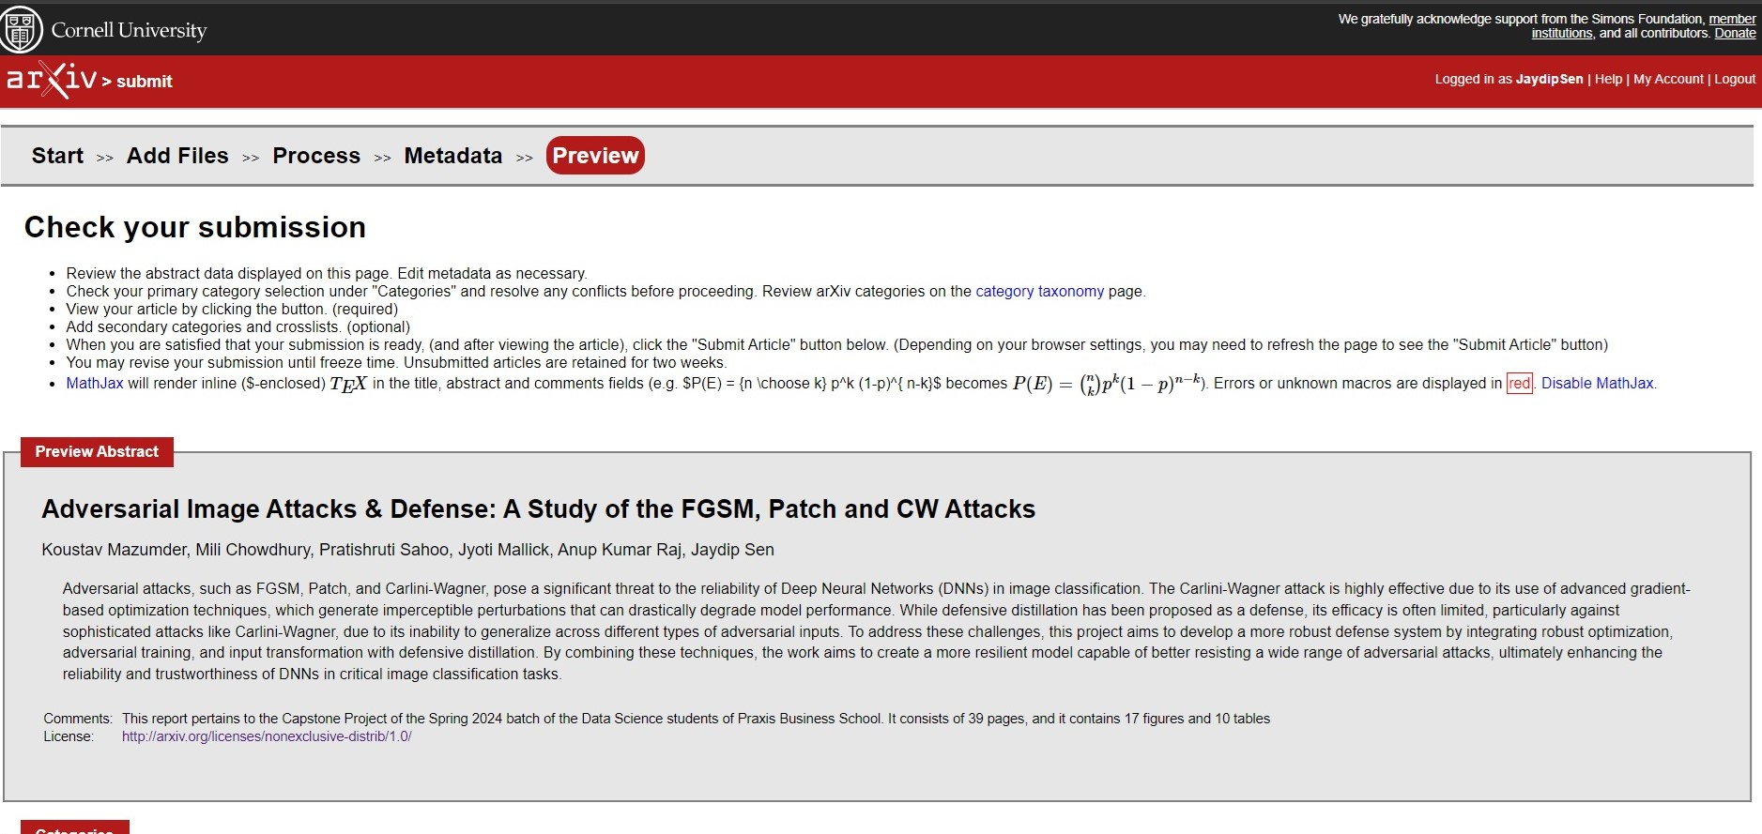
ARXIV and Research Gate Upload
Research Gate Reference link : https://www.researchgate.net/publication/384459218_Adversarial_Image_Attack_Defenses_A_Study_of_effects_of_FGSM_Patch_and_CWAttack

Slide 36
References
1. I. J. Goodfellow, J. Shlens, and C. Szegedy, “Explaining and harnessing adversarial examples,” arXiv preprint arXiv:1412.6572, 2014.
2. F. Tramer et al, “Ensemble Adversarial Training: Attacks and Defenses,” arXiv:1705.07204v5 [stat.ML], ICLR 2018.
3. Long Dang et al, “Improving Machine Learning Robustness via Adversarial Training,” arXiv:2309.12593v1. 4. A. Madry, A. Makelov, L. Schmidt, D. Tsipras, and A. Vladu, “Towards deep learning models resistant to adversarial attacks,” arXiv preprint arXiv:1706.06083, 2017.
N. Carlini and D. Wagner, “Adversarial examples are not easily detected: Bypassing ten detection methods,” in Proceedings of the 10th ACM workshop on artificial intelligence and security, 2017, pp. 3–14.
J. Sen and S. Dasgupta, “Adversarial attacks on image classification models: FGSM and patch attacks and their impact,” arXiv preprint arXiv:2307.02055, 2023.
H. Waghela, J. Sen and S. Rakshit, “Saliency Attention and Semantic Similarity-Driven Adversarial Perturbation,” ICDSA 24, July 17-19, 2024.
C. Pestana, W. Liu, D. Glance, A. Mian, “Defense-friendly Images in Adversarial Attacks: Dataset and Metrics for Perturbation Difficulty,”.
Naveed Akhtar, Jian Liu, and Ajmal Mian. Defense against universal adversarial perturbations. In Proceedings of the IEEE Conference on Computer Vision and Pattern Recognition, pages 3389–3398, 2018. 10. Camilo Pestana, Naveed Akhtar, Wei Liu, David Glance, and Ajmal Mian. Adversarial Perturbations Prevail in the Y-Channel of the YCbCr Color Space. arXiv e-prints, page arXiv:2003.00883, Feb. 2020.
Carlini, N., & Wagner, D. (2017). Towards Evaluating the Robustness of Neural Networks. IEEE Symposium on Security and Privacy (SP), 39-57. DOI: 10.1109/SP.2017.49.
Papernot, N., McDaniel, P., Wu, X., Jha, S., & Swami, A. (2016). Distillation as a Defense to Adversarial Perturbations Against Deep Neural Networks. 2016 IEEE Symposium on Security and Privacy (SP), 582-597. DOI: 10.1109/SP.2016.41.
Huang, G., Liu, Z., Van Der Maaten, L., & Weinberger, K. Q. (2017). Densely Connected Convolutional Networks. Proceedings of the IEEE Conference on Computer Vision and Pattern Recognition (CVPR), 2017, pp. 4700-4708.
14. He, K., Zhang, X., Ren, S., & Sun, J. (2016). Deep Residual Learning for Image Recognition. Proceedings of the IEEE Conference on Computer Vision and Pattern Recognition (CVPR), 2016, pp. 770-778. DOI: 10.1109/CVPR.2016.90.
Tan, M., & Le, Q. V. (2019). EfficientNet: Rethinking Model Scaling for Convolutional Neural Networks. Proceedings of the 36th International Conference on Machine Learning, PMLR 97:6105-6114, 2019. arXiv:1905.11946.
Sec, I. (2021, March 6). VGG-19 Convolutional Neural Network. All About Machine Learning. https://blog.techcraft.org/vgg-19-convolutional-neural-network

Slide 37
THANK YOU

